Slide 1

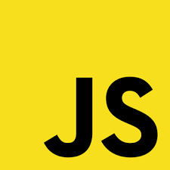

Slide 2
What is Javascript?
javaScript is a scripting or programming language that allows you to implement complex features on web pages — every time a web page does more than just sit there and display static information for you to look at — displaying timely content updates, interactive maps, animated 2D/3D graphics, scrolling video jukeboxes, etc.

Slide 3
So what can it really do?

Slide 4
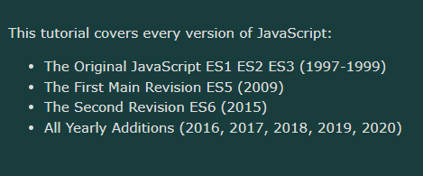
History Of Javascript

Slide 5
Why do We learn Javascript?

Slide 6

How to run a js code in your browser

Slide 7
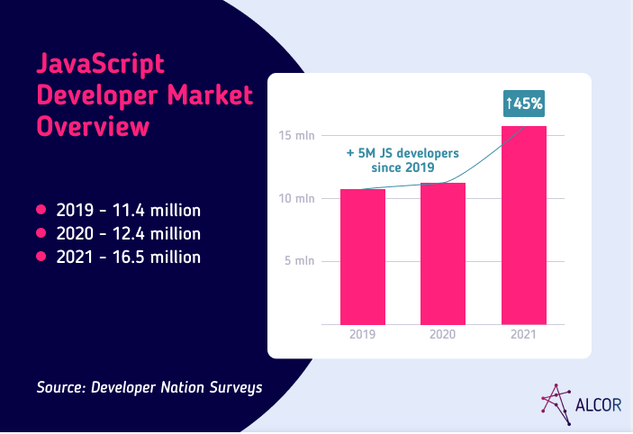
JavaScript Global Market Trend

Slide 8
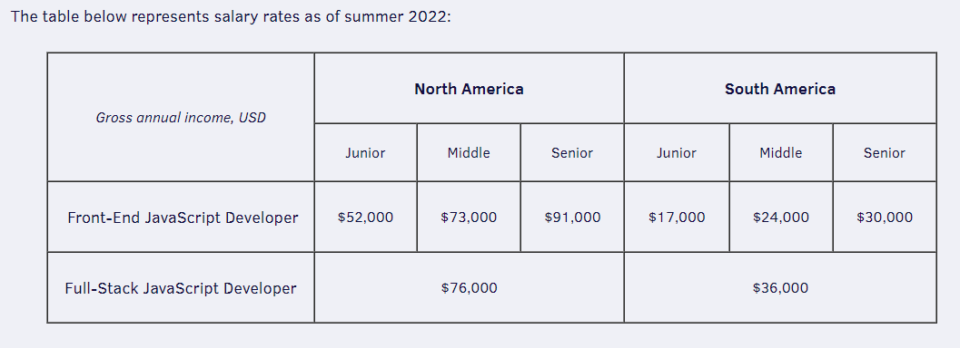
America Market Demand

Slide 9
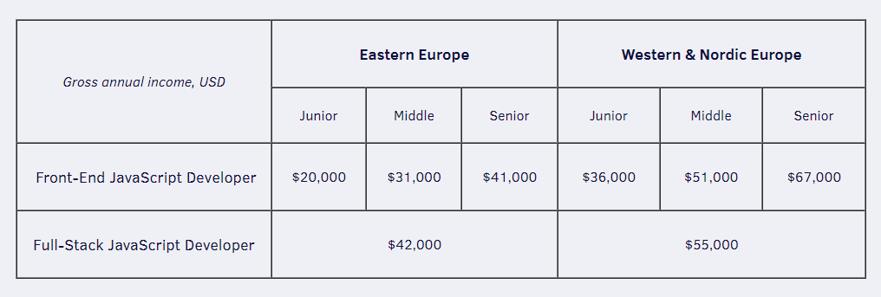
America Market Demand

Slide 10
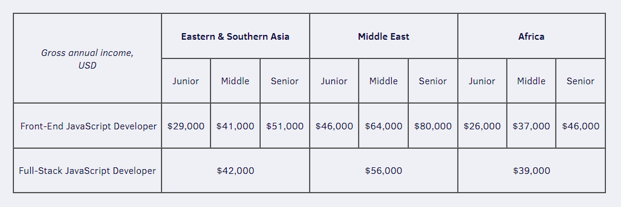
Asia Market Demand

Slide 11
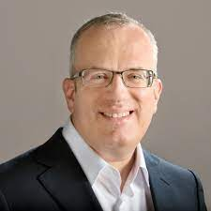
Brendan Eich
JavaScript was invented by Brendan Eich in 1995. It was developed for Netscape 2, and became the ECMA-262 standard in 1997. After Netscape handed JavaScript over to ECMA, the Mozilla foundation continued to develop JavaScript for the Firefox browser. Mozilla's latest version was 1.8

Slide 12
JavaScript
Day 03

Slide 13
Javascript Data Type

Slide 14
JavaScript has 8 Datatypes
1. STRING 2. NUMBER 3. BIGINT 4. BOOLEAN 5. UNDEFINED 5. NULL 7. SYMBOL 8. OBJECT

Slide 15
The Object Datatype
The object data type can contain:
1. An object 2. An array 3. A date

Slide 16
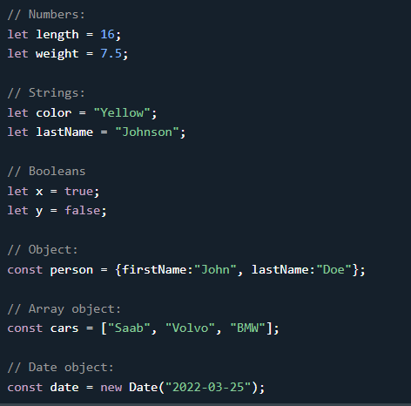
DataType Examples

Slide 17
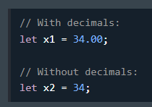
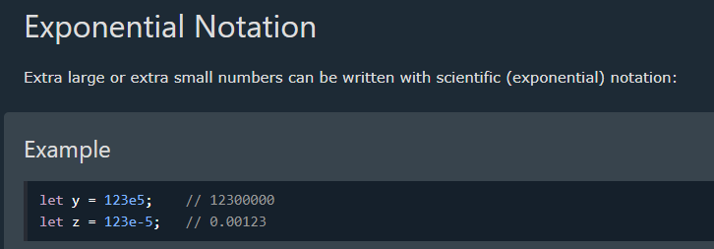
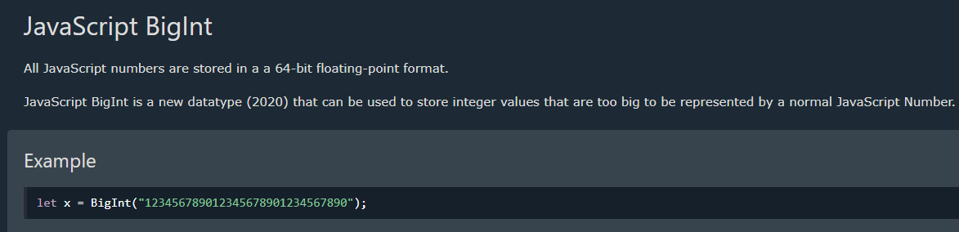
DataType : Numbers

Slide 18
JavaScript

Slide 19
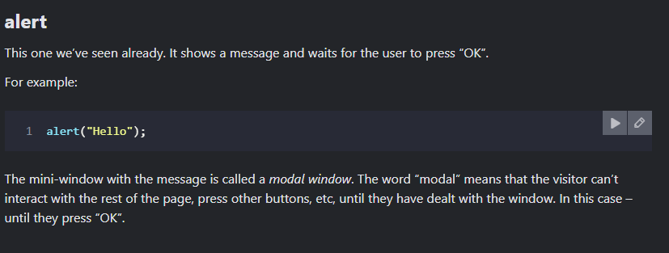
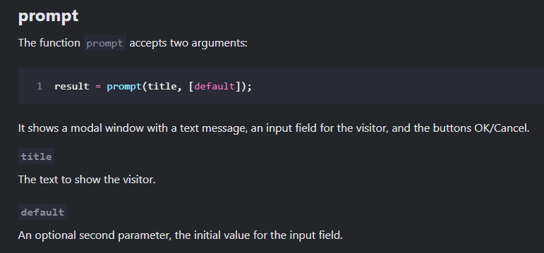
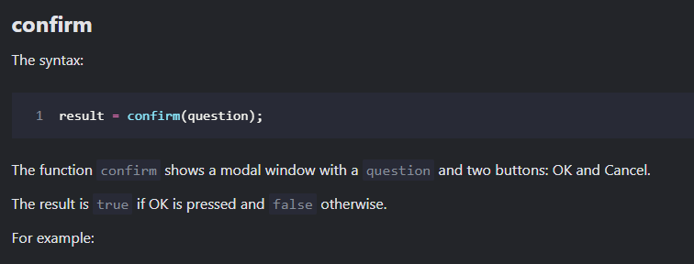
Interaction: alert, prompt, confirm

Slide 20
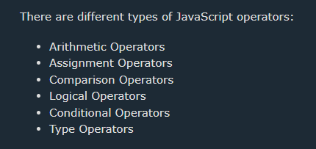
Type of JavaScript Operator

Slide 21
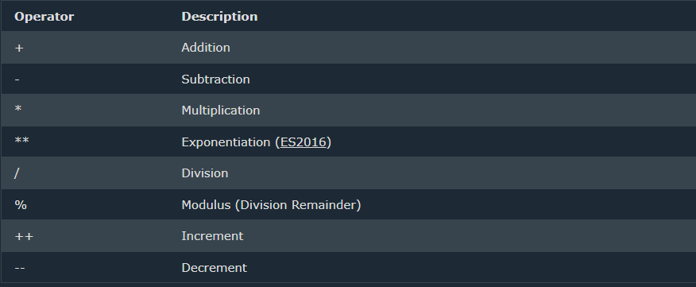
JavaScript Arithmetic Operator

Slide 22
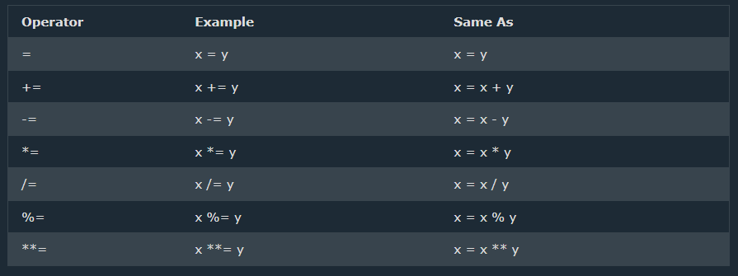
JavaScript Assignment Operator

Slide 23
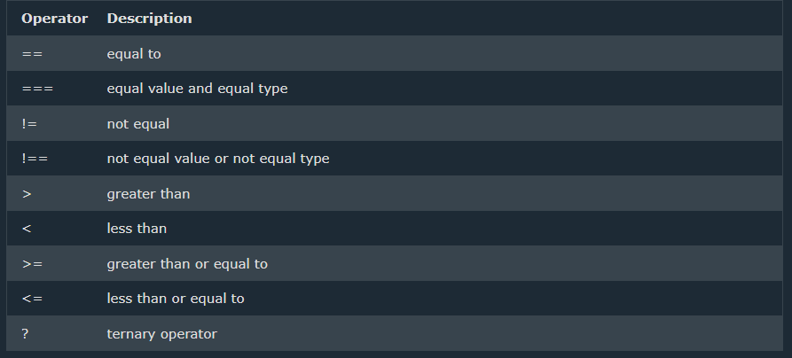
JavaScript Comparison Operator

Slide 24
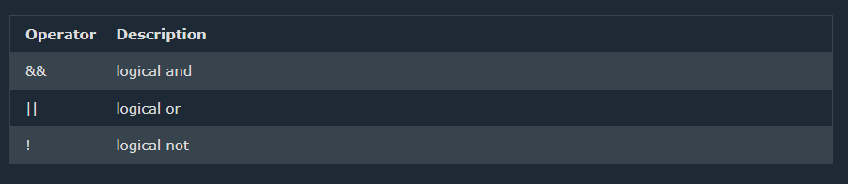
JavaScript Logical Operator

Slide 25
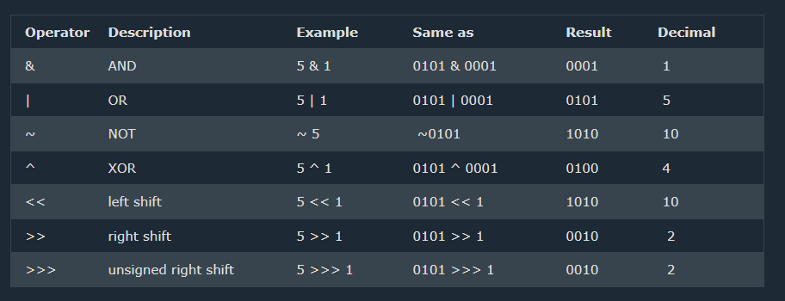
JavaScript Bitwise Operator

Slide 26
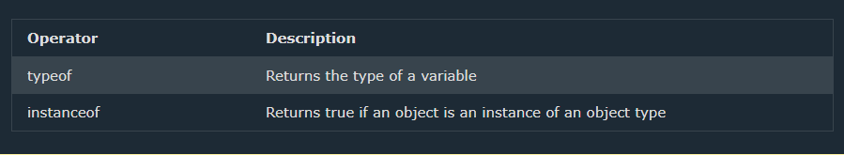
JavaScript Type Operator

Slide 27
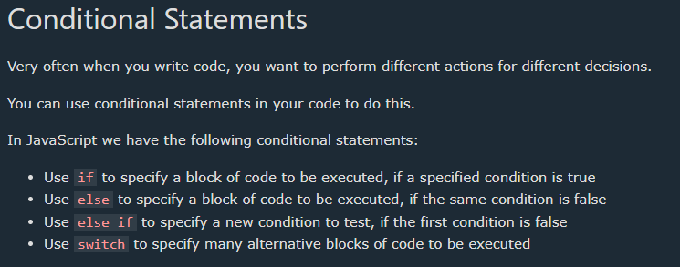
JavaScript Type Operator

Slide 28
JavaScript
Day 06

Slide 29
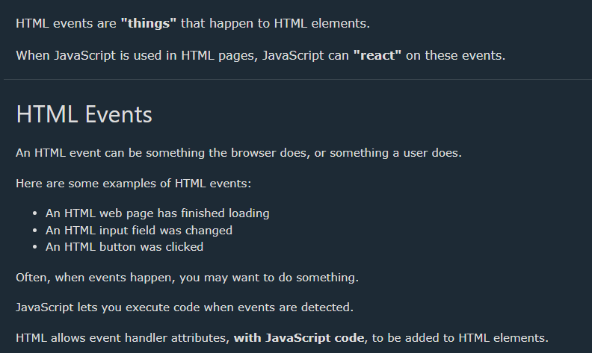
JavaScript Event

Slide 30
How to add JS Event

Slide 31
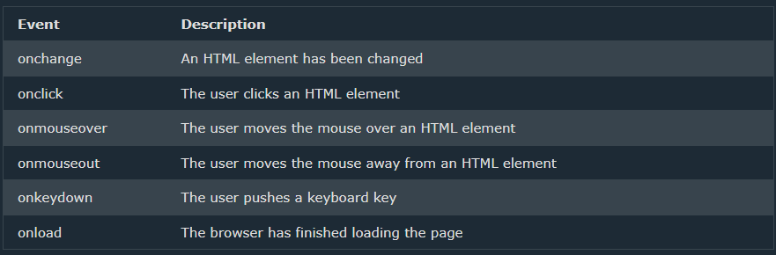
HTML ALL EVENTS

Slide 32
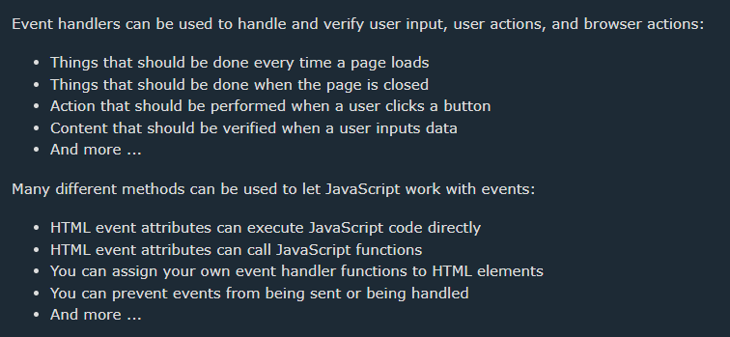
JavaScript Event Handler

Slide 33
JavaScript
Day 08

Slide 34
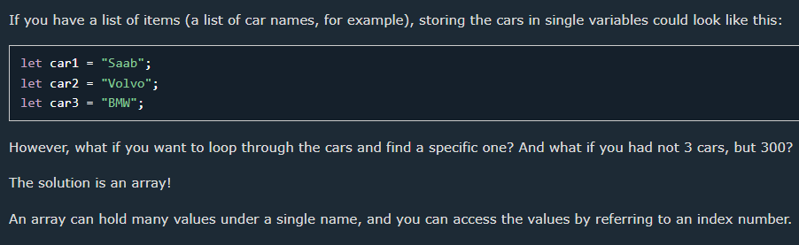
Why Use Arrays?

Slide 35
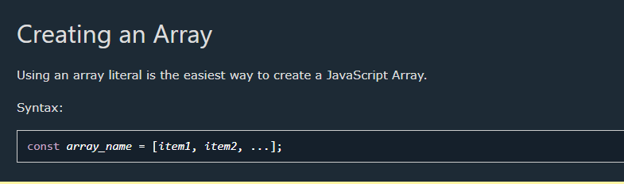
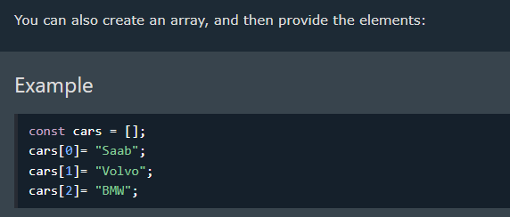
.

Slide 36
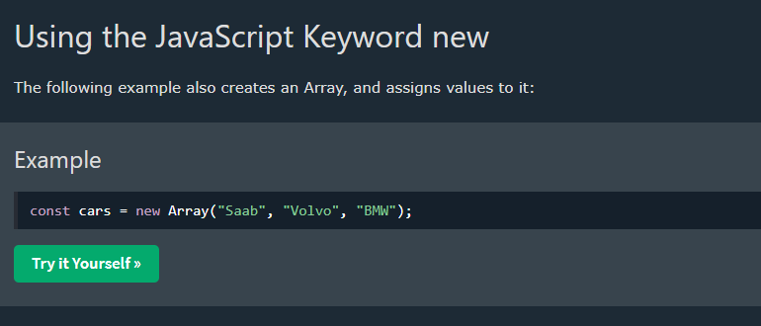
.Js Keyword new

Slide 37
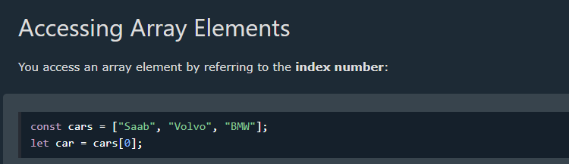
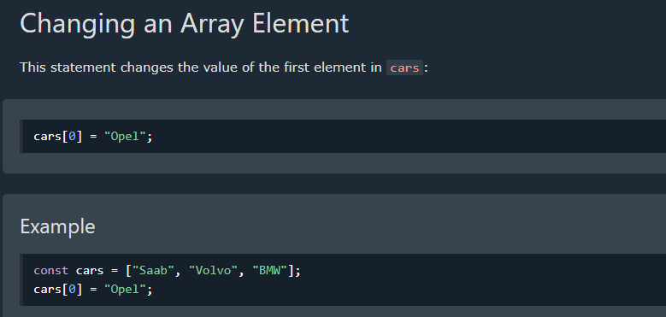
.

Slide 38
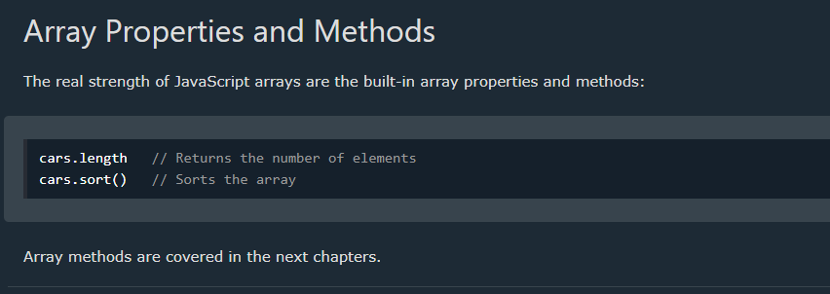
.

Slide 39
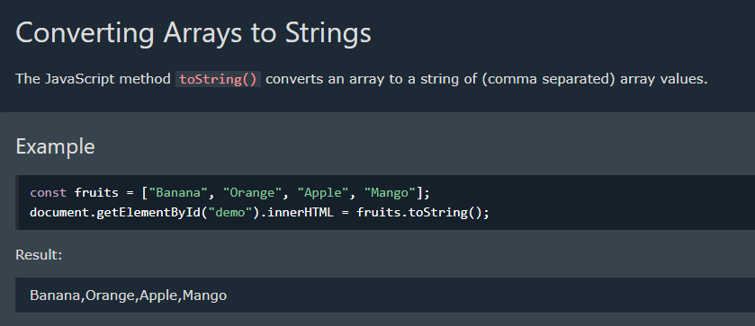
Array to strings

Slide 40
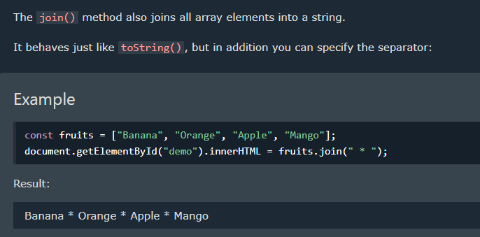
.

Slide 41
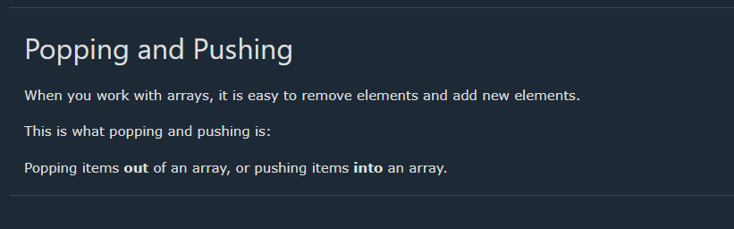
.

Slide 42
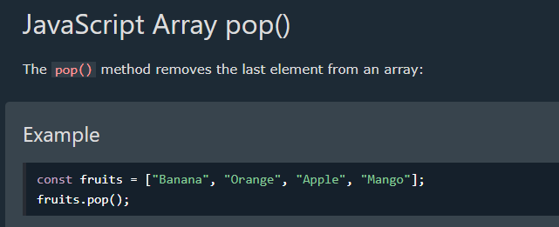
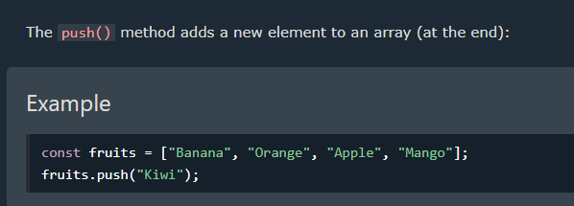
.

Slide 43
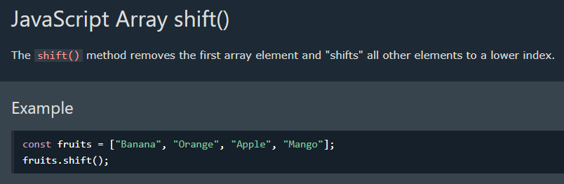
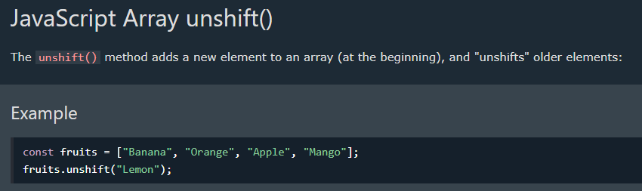
.

Slide 44
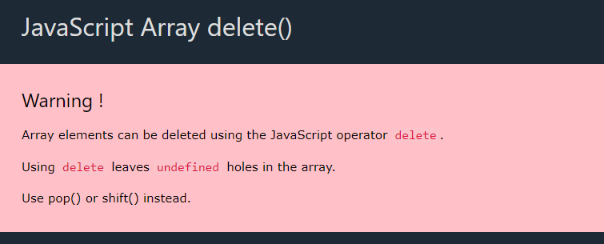

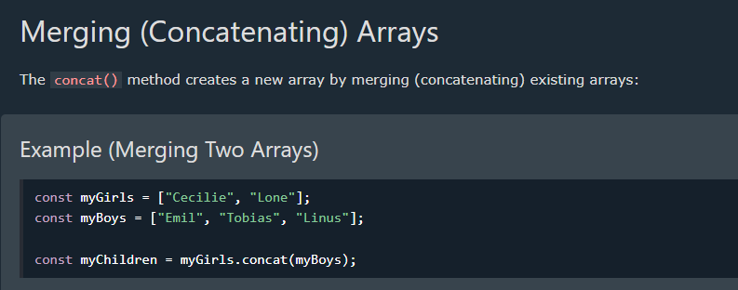

Slide 45
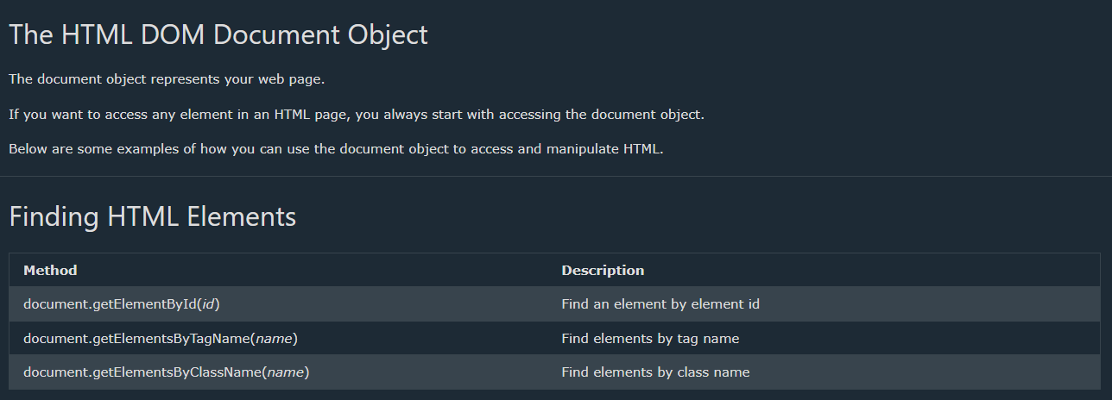

Slide 46
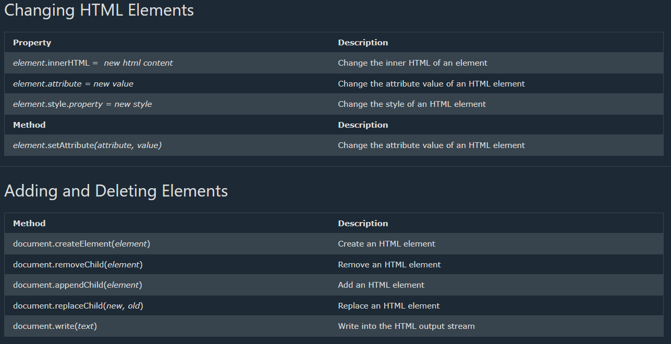

Slide 47
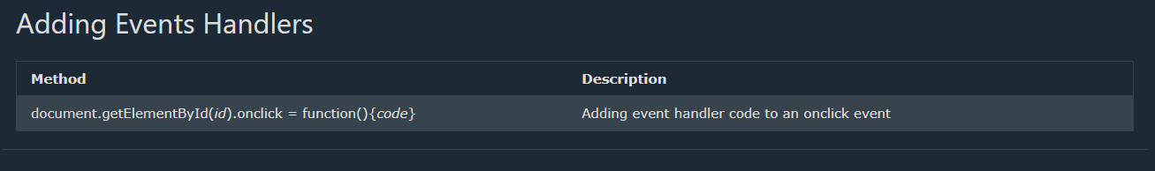

Slide 48
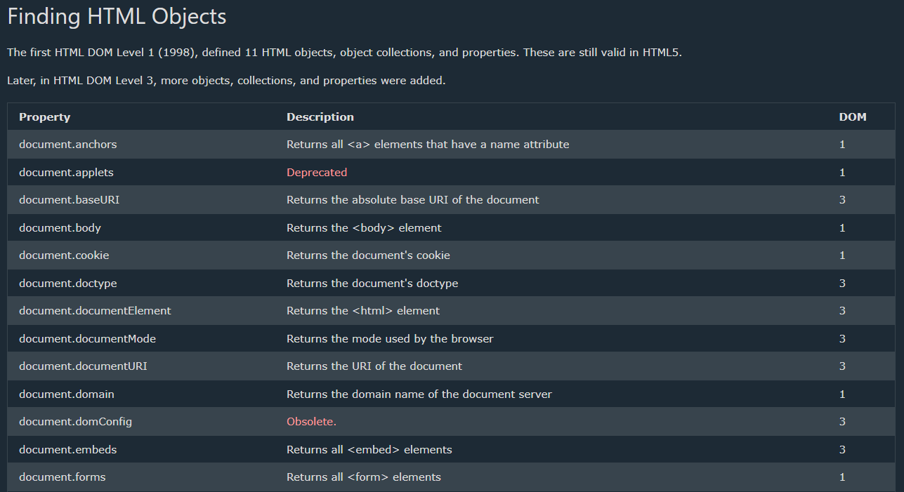

Slide 49
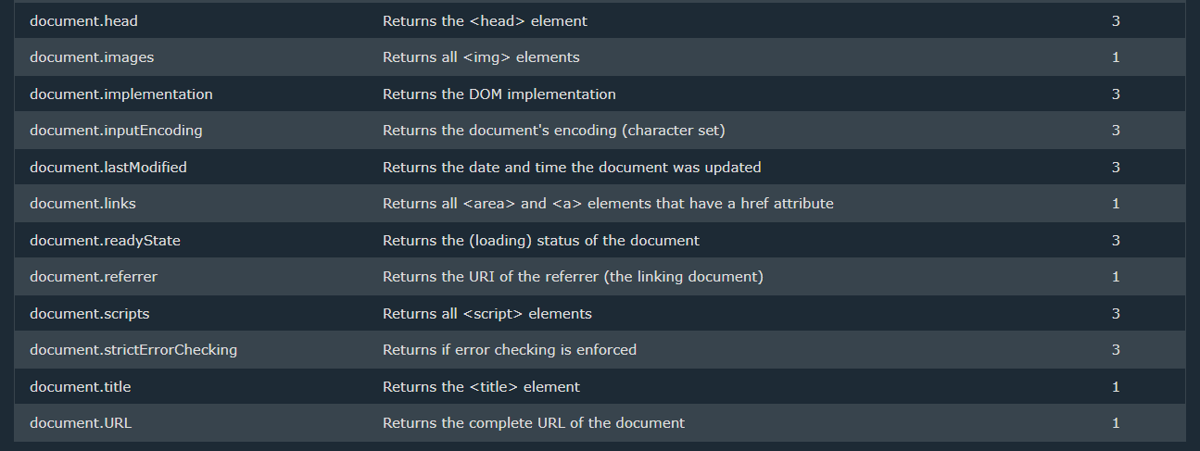

Slide 50
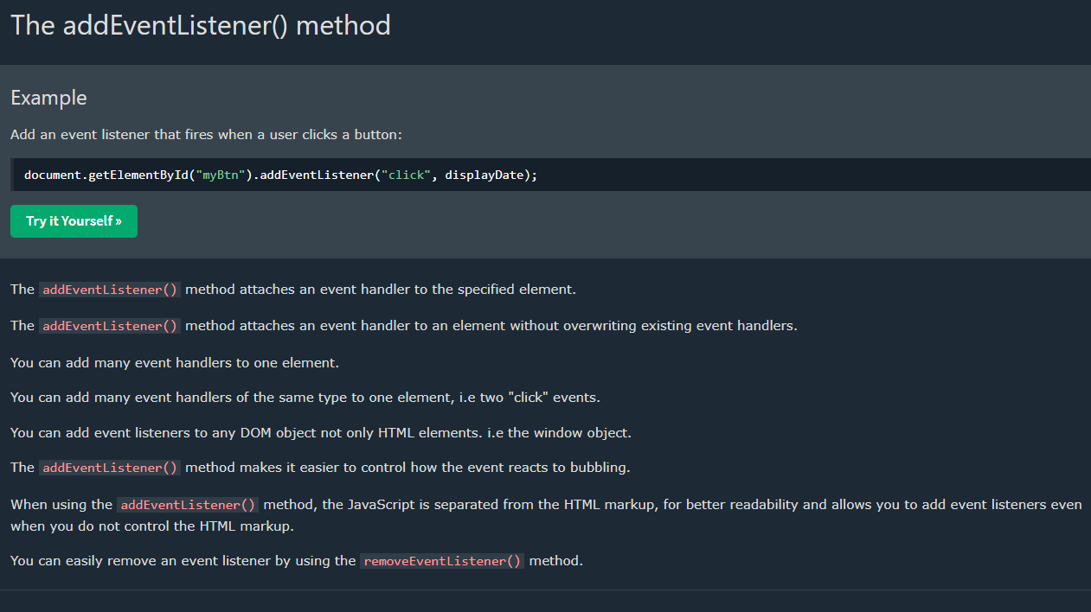

Slide 51
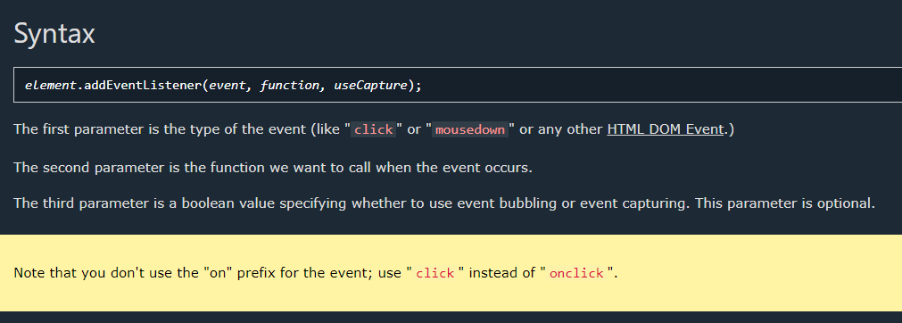

Slide 52
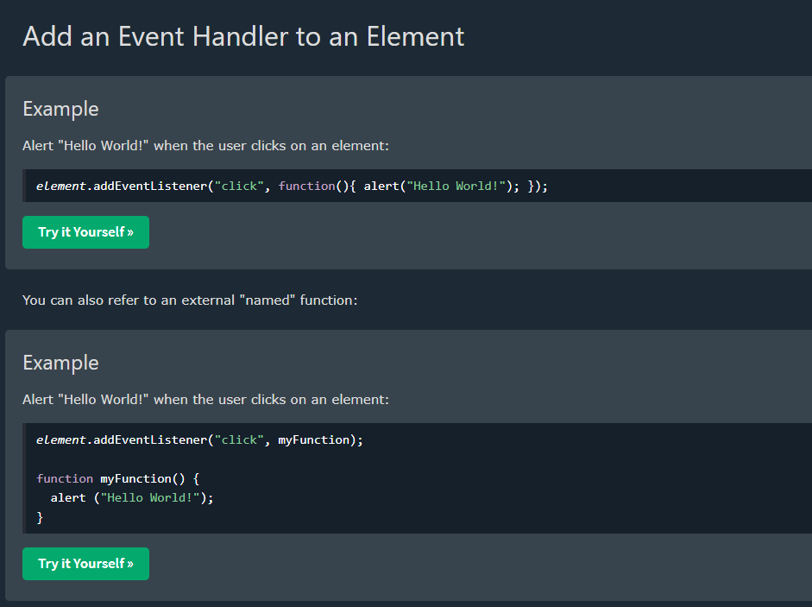

Slide 53
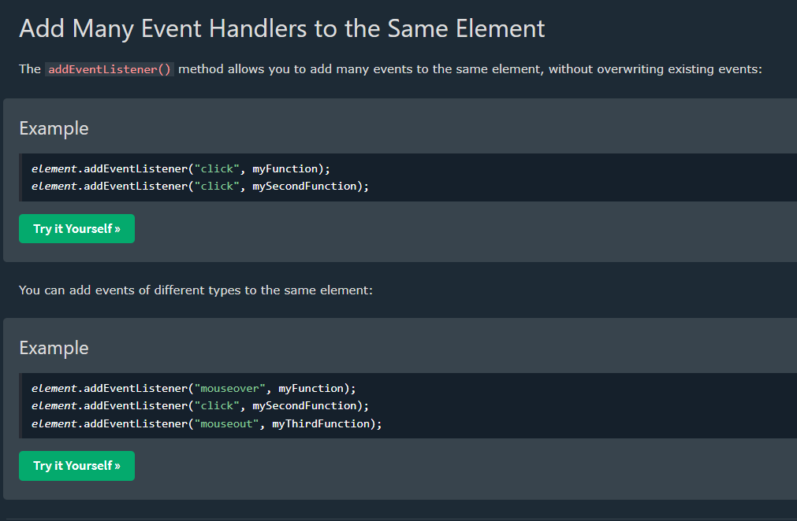

Slide 54


Slide 55


Slide 56
JavaScript
Regular Expression
Day 13

Slide 57


Slide 58


Slide 59


Slide 60


Slide 61




Slide 62



Slide 63


Slide 64


Slide 65


Slide 66


Slide 67


Slide 68


